Slide 1

Notes:
Hello everyone, thank you for being here today. I know it's the last day of presentations [and I think the last class we all have together] and you all probably just wannna go home, but I appreciate you being here anyways. As some of you may recall, I'm Sarah of team Tomodachi, and with me today are my fellow compatriots Andrew, Windjy, Patrick, and other Patrick. [Also very kindly joining us is our benevolent benefactor, Steve Bulgin - please help me give a warm welcome for Steve!] Unfortunately, our benevolent benefactor - Steve Bulgin - will not be joining us tonight as he has a vital playoff game. He did not specify which sport, so I'm just going to assume he's playing for the Leafs. Go Steve! We are one of two groups recruited to realize Steve's passion project, PoGo Gakko; PoGo being derived from Pokemon Go, and Gakko meaning school.

Slide 2

Notes:
So what is Pokemon Go? As I'm sure most of you know or have heard, Pokemon Go is the popular augmented reality mobile game developed and published by Niantic. It creates a unique Pokemon experience by overlaying Pokemon into the real world through your mobile camera lens. Furthermore - Pokestops, which you can spin for items; Gyms, where you can battle other trainers; and Raids, where you can fight and capture possibly rare Pokemon - can be found at notable real world locations. This gives players a great incentive to get active and go out into their local communities.

Slide 3
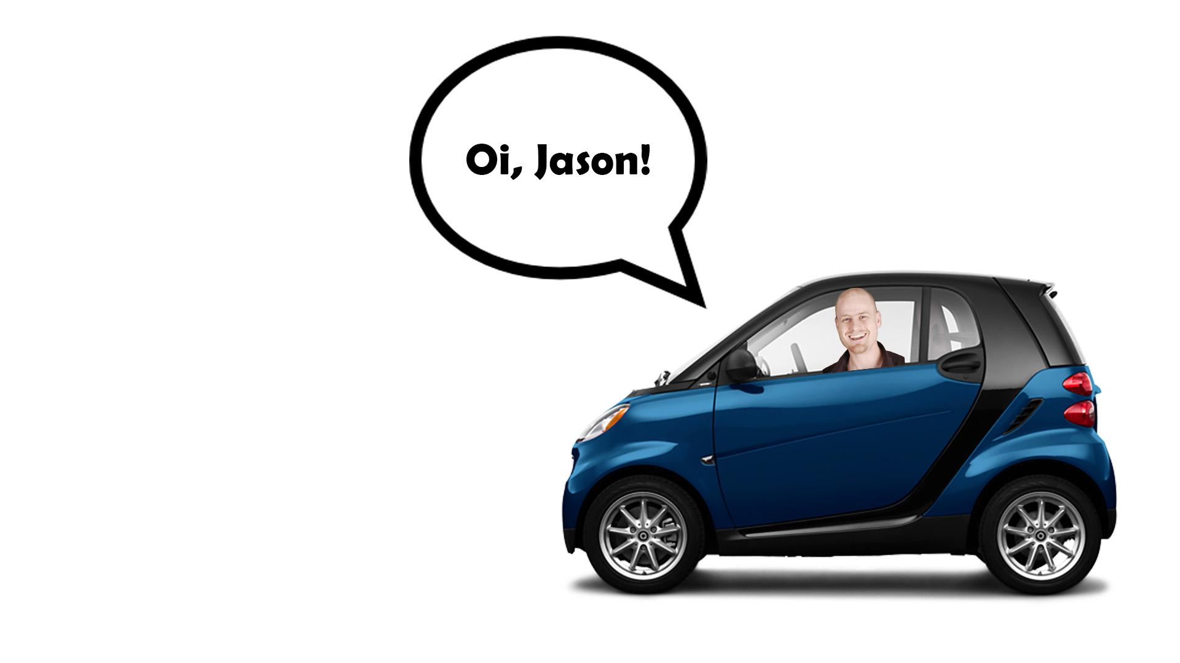
Notes:
There's just one small issue... Say Steve wants to do a Raid. Now Steve is a Pokemon master, if there ever was one. But even Steve needs help sometimes. So Steve calls up his buddy Jason and is like... "Oi, Jason! - [you can tell we weren't expecting him to be here] he totally sounds like that by the way - You wanna go catch 'em all?" And Jason is like... "I sure do love me some Pokemon Steve, but how do I done know where y'all gon' go?" So to fix this communication issue, Steve came up with the idea of PoGo Gakko, a community-based and community-driven mobile web application that would allow users to connect, to customize their experience, to share information, to participate in events - and so much more.

Slide 4
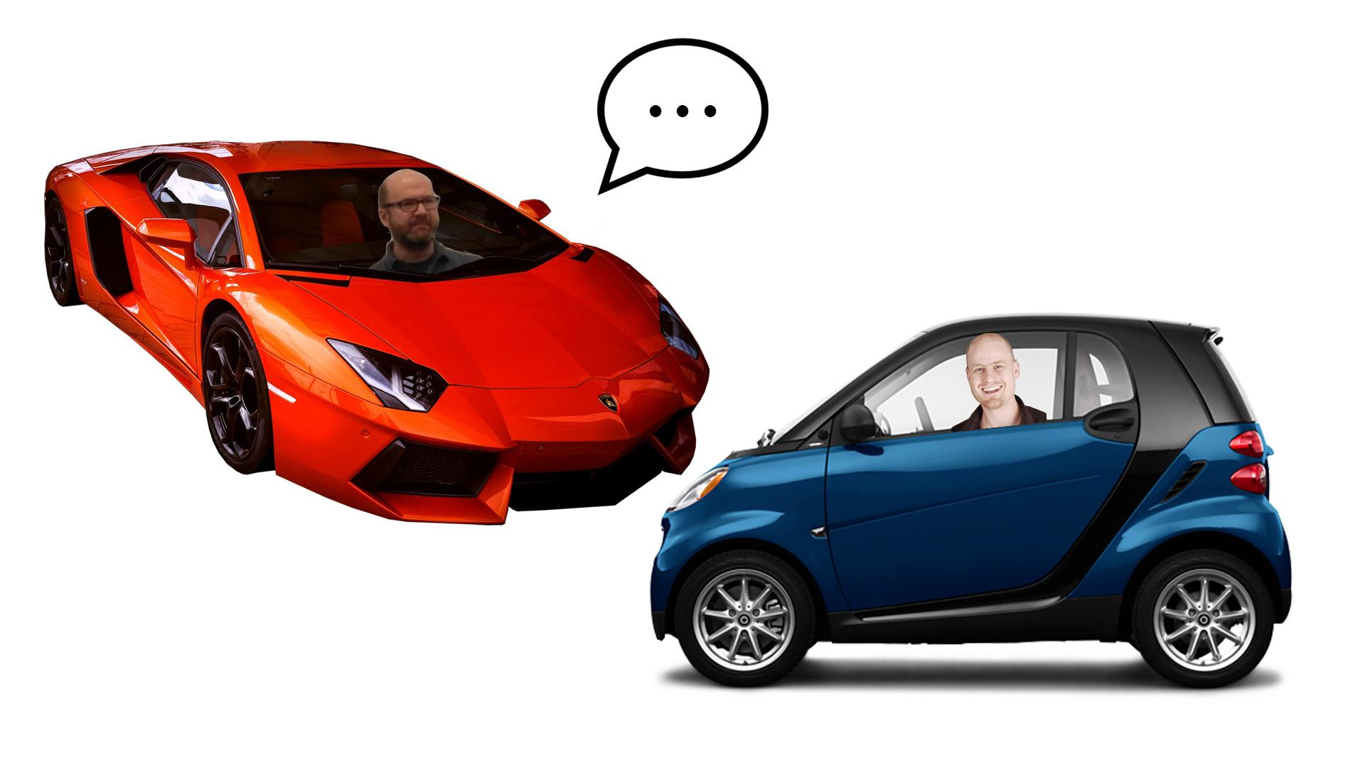

Slide 5
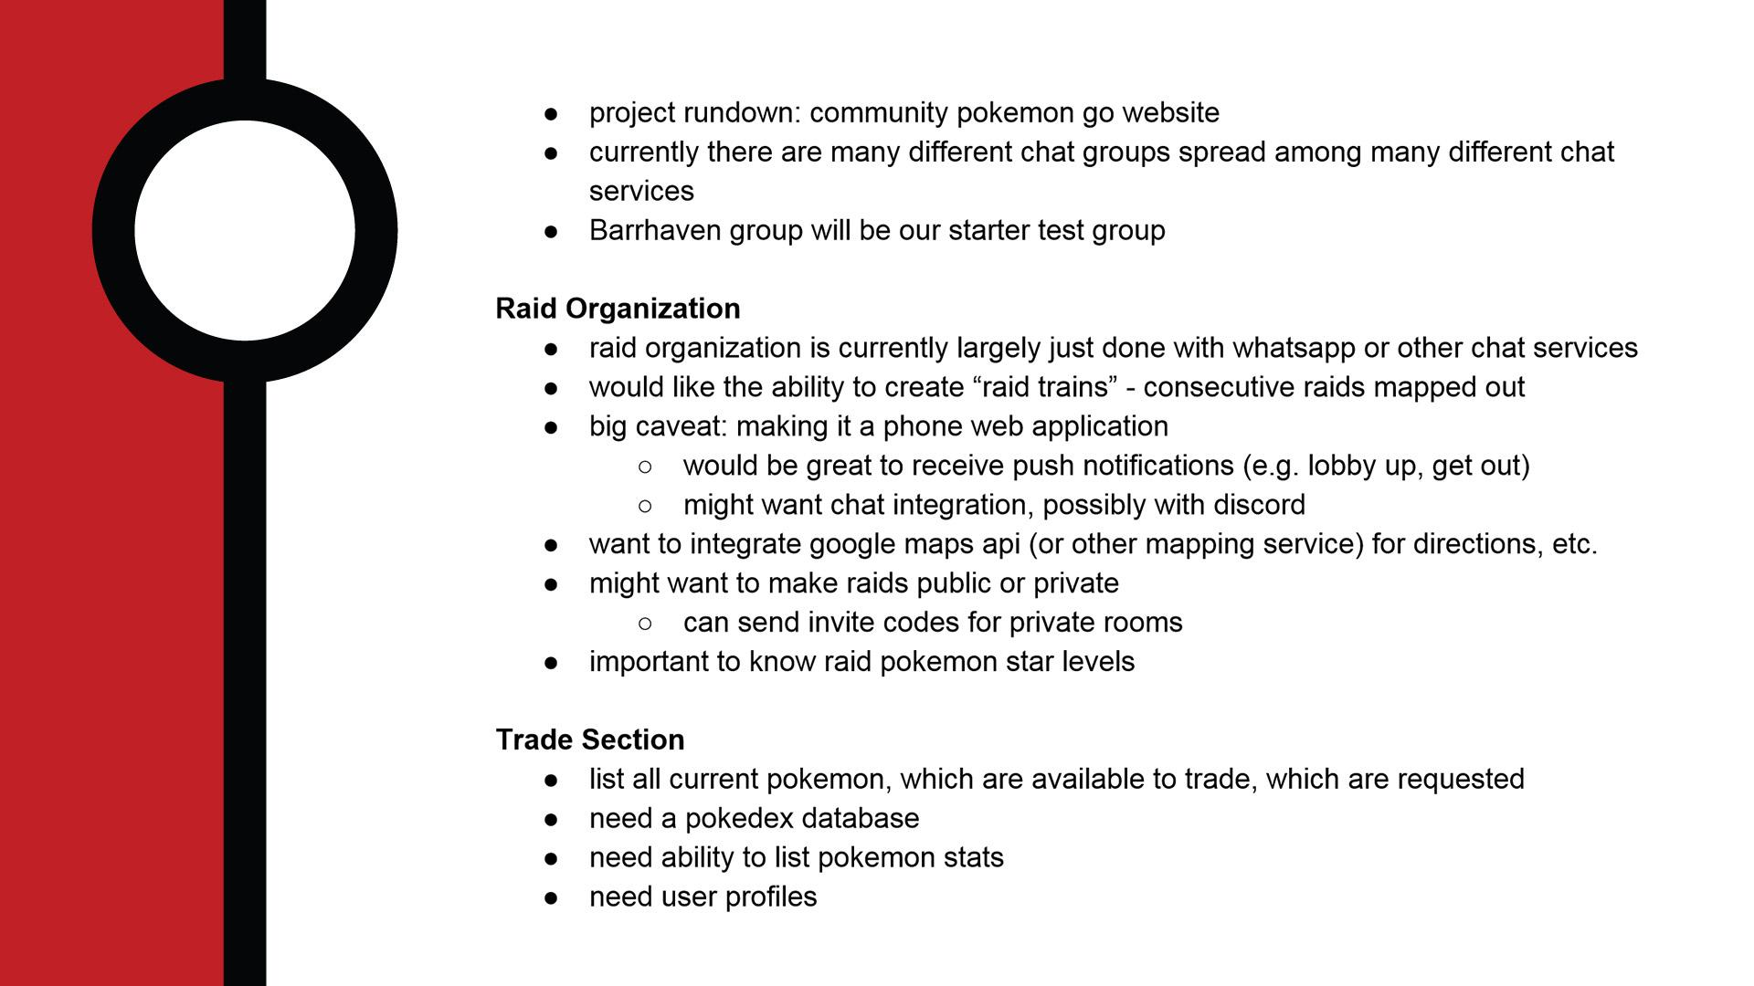
Notes:
Now Steve had many, many, many ideas... But as far as clients go, he already had a vast amount of experience in this field, so he was happy to just take a backseat and see what we came up with. We could tell right away that this was not going to be an independent, isolated, neatly-packaged 4-month long project based on the complexity of the functionalities required, so we set our primary goal as building a strong foundation onto which future teams could scaffold additional features. Due to our time constraints, we also had to examine for ourselves what Steve really wanted - what drove him to chase this idea in the first place, and to us, that was to allow groups of players to coordinate raids together. And in order to have that, we needed a system that could authenticate and recognize individual players in a database. So we started with just that - a user profile.

Slide 6
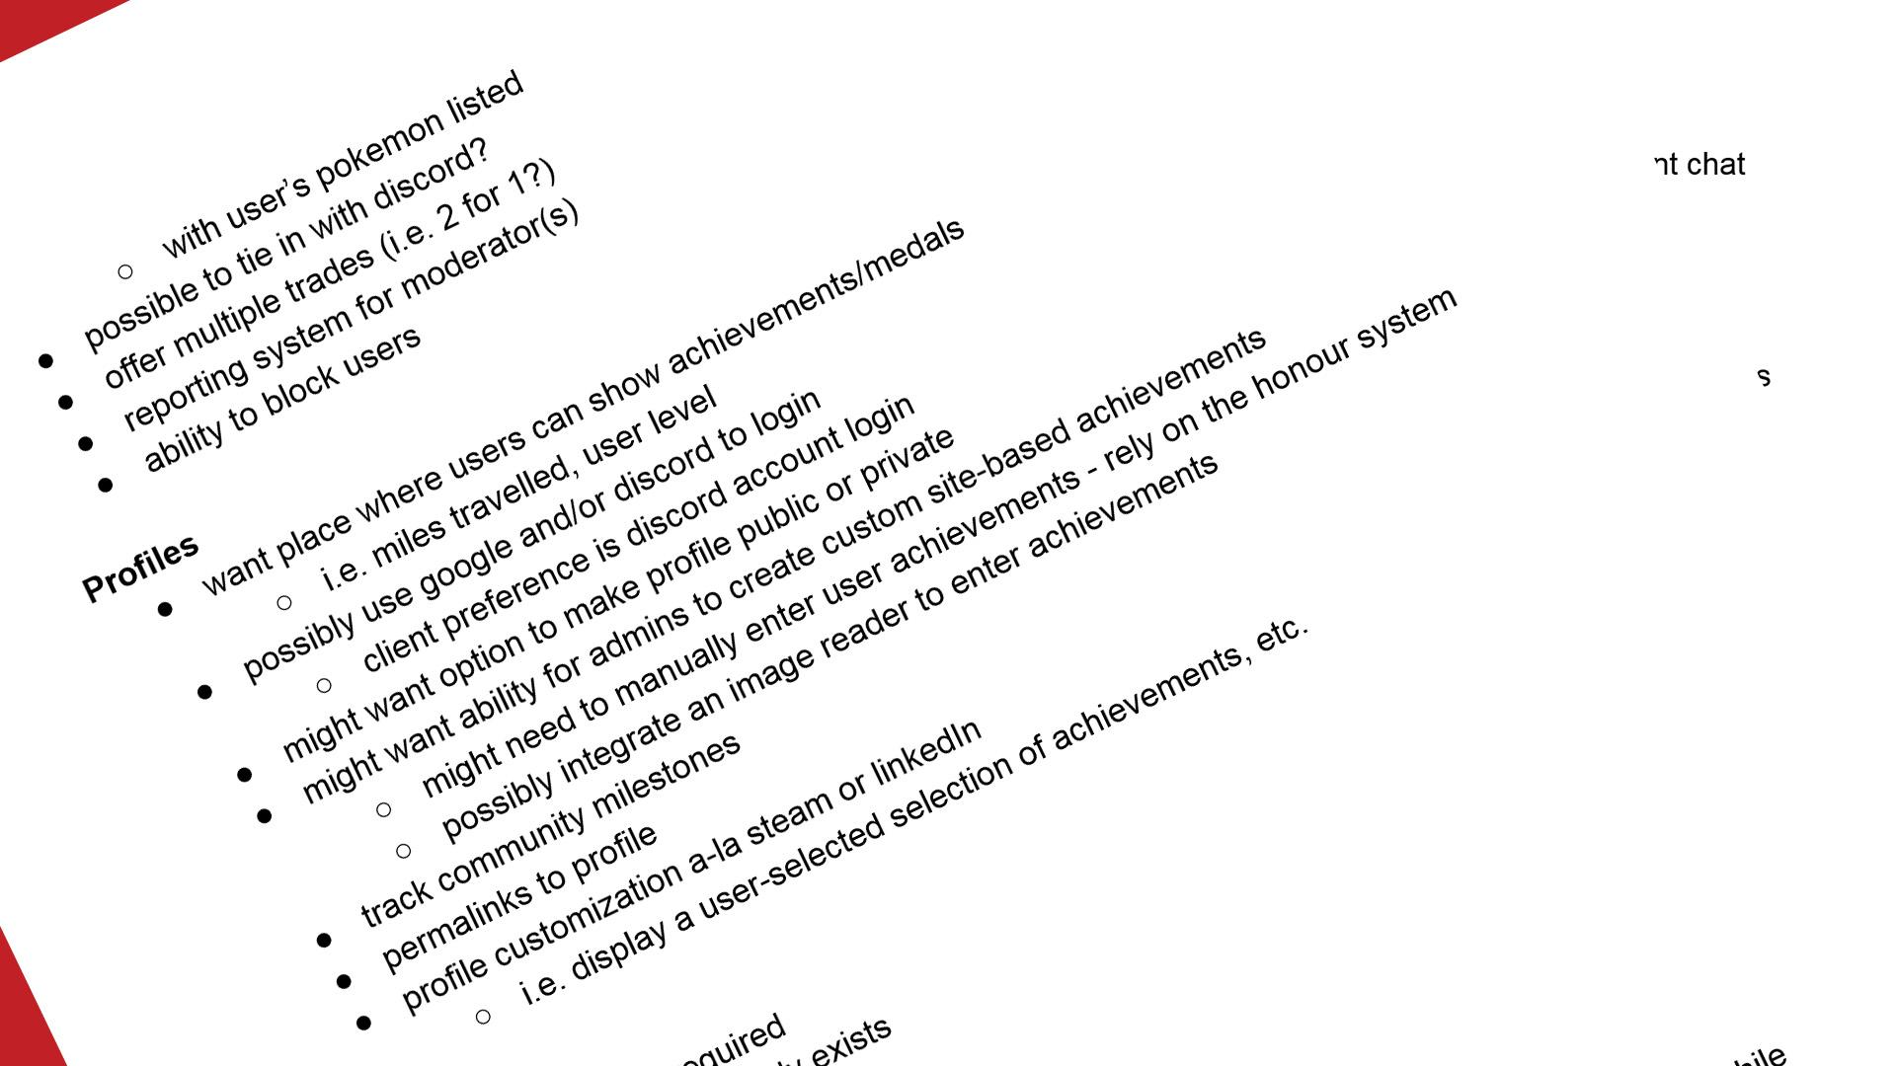

Slide 7
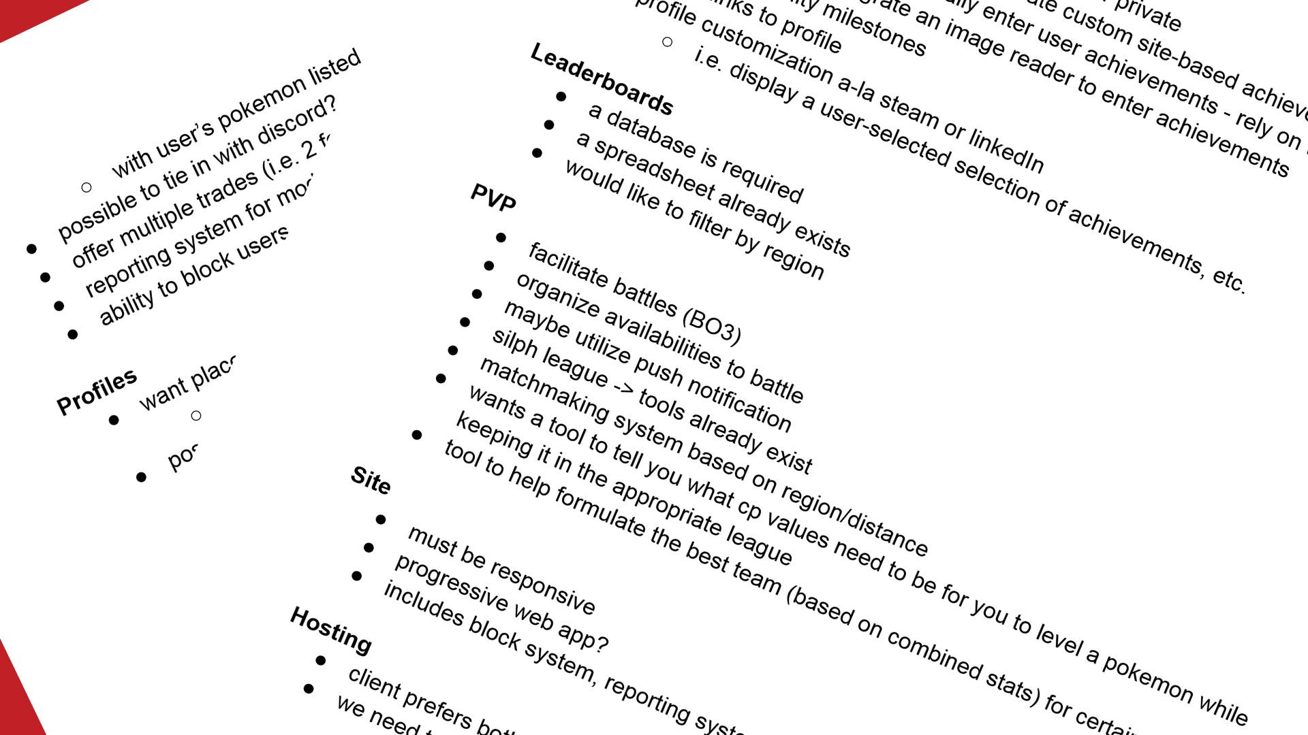

Slide 8
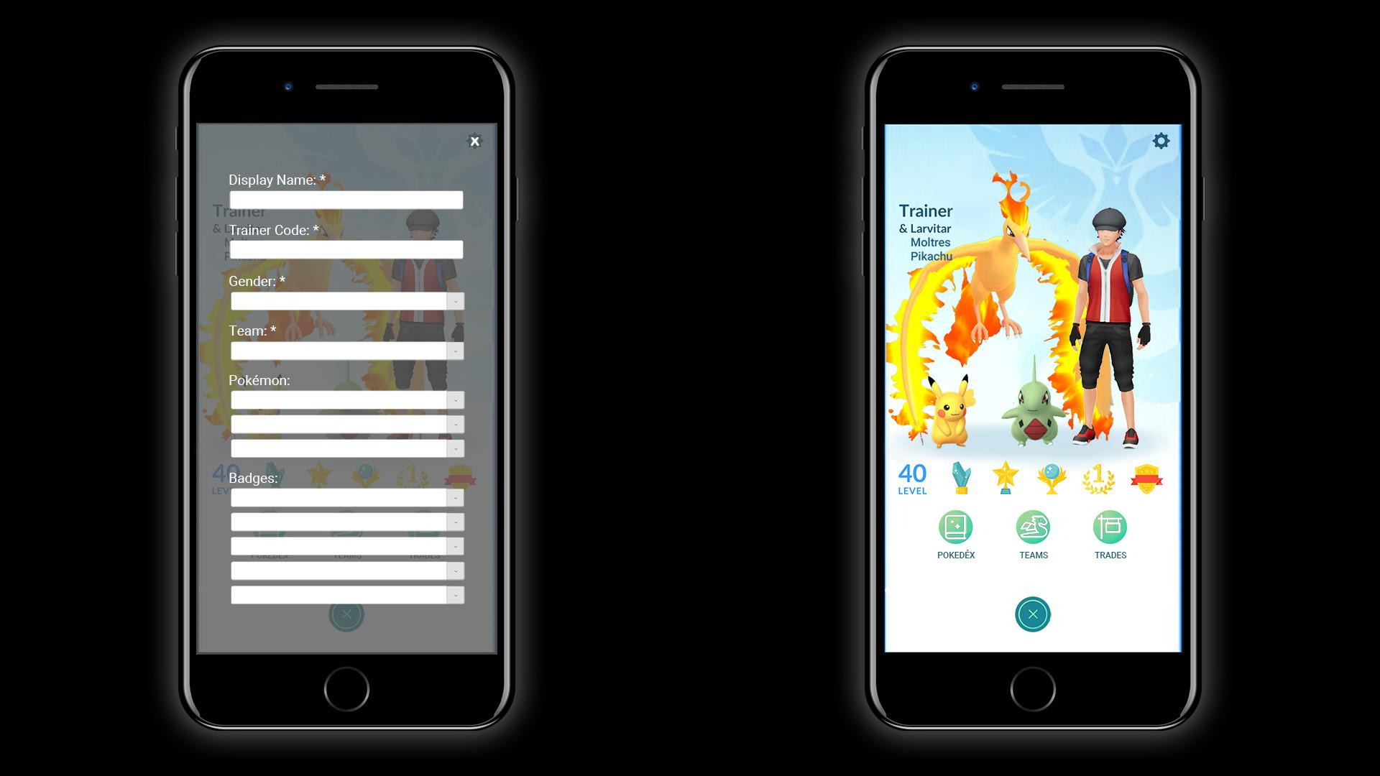
Notes:
Here are the mockups we visualized; when a player is authenticated through Google or Discord, they're presented with a setup (and later settings) screen… [EXPLAIN]

Slide 9
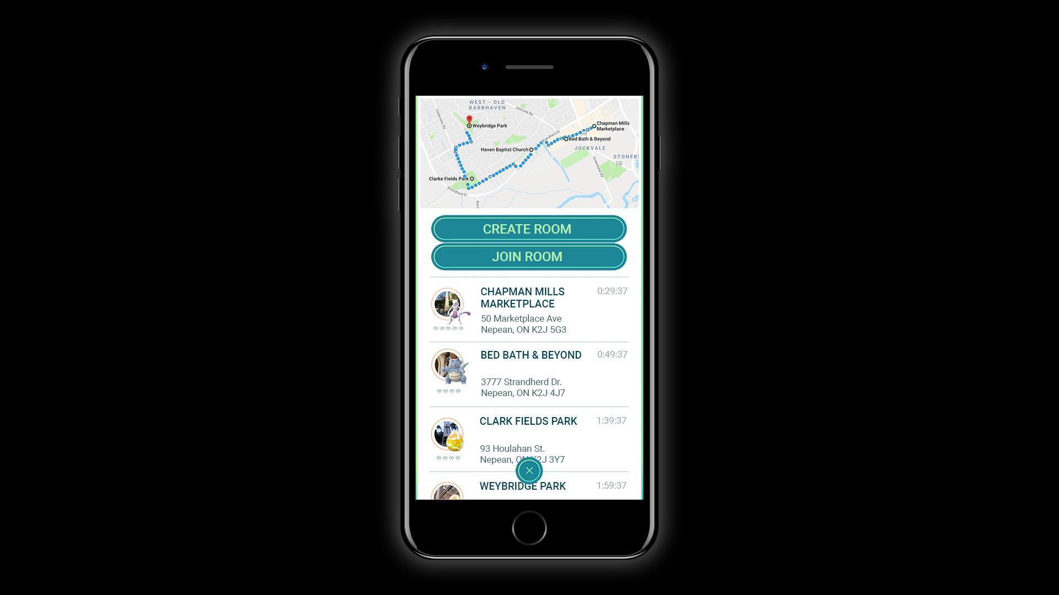
Notes:
Thereafter, players can access the raids menu… [EXPLAIN]

Slide 10
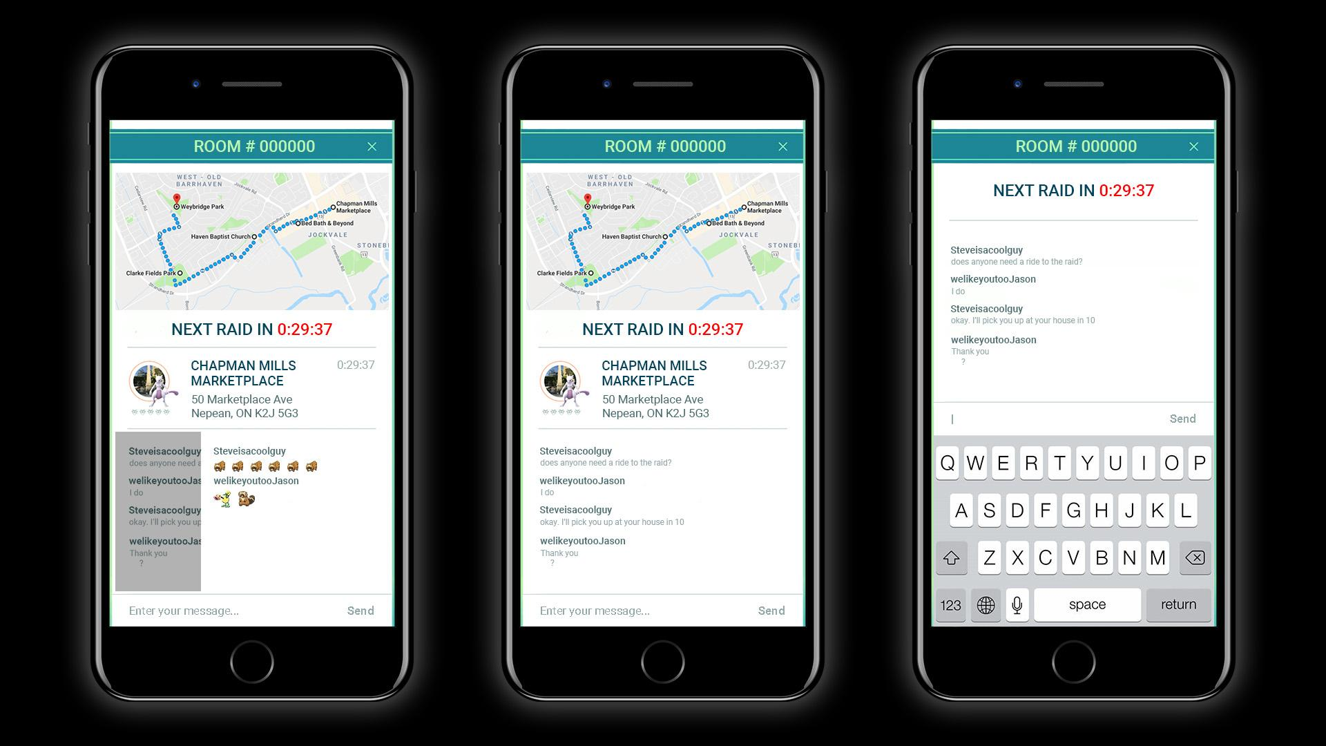
Notes:
Inside a raid room… [EXPLAIN]

Slide 11
Project Management
Communication
Documentation
Command Structure
Resource Management
Research
Notes:
Thank you Sarah. Hey folks. As already mentioned, I am the project manager for Team Tomodachi. I will briefly explain the management aspect of our journey, and I will break it down in the following 5 categories: (read off powerpoint).

Slide 12


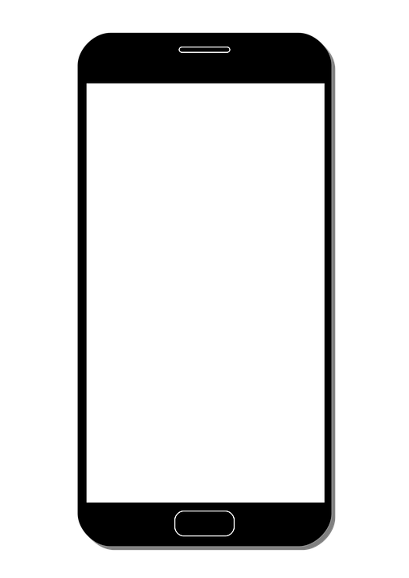
Communication
Internal
Discord
Get-Togethers
Concentrated Weekends at Sarah’s
External
Emails every 2-3 Weeks
Discord for Small Updates
Phone Calls
Notes:
Nothing fancy here, we just used Discord, our time together at school, and worked at Sarah’s humble abode to communicate and get work done.
As for our communications with our client, Steve, we contacted him via email bi-weekly, spoke to him via Discord and called him every now and then to either discuss future plans or to find him roaming in hallway.

Slide 13




Documentation
Technical Recommendation
Architecture Diagram
Storyboard
Gantt Chart
Mockups
Meeting Minutes
And more!
All hosted on Github
Notes:
In addition to the Creative Brief, we’ve created several documents to assist with laying out the project and explaining the application. (Read off powerpoint)

Slide 14
Command Structure
Nearly Maximum Autonomy
Tasks
Back-End
Front-End
Web Design
Graphic Design
Research
Documentation
Secretary Work
Notes:
Concerning our command structure, I used a nearly maximum autonomous method of managing. Given our history as colleagues, I trusted them to get the work done. Obviously, this will rarely work in a real-life situation. Don’t try it.
As for tasks, there’s five main elements: Back-End, Front-End, Documentation, Research and Secretary Work (next slide)

Slide 15
Resource Management
Placed everyone into their strongest positions
Back-End
Andrew, Patrick G
Front-End
Patrick C, Sarah, and Windjy
Notes:
[Read Slides]

Slide 16
Research
Ionic vs. React Native
Angular
Mapping
Real-Time Notifications
Graphical Assets
The game itself!
Service Discovery
Microservices
Monolithic Structures/Design
Authentication
Docker
RabbitMQ
Notes:
[Read Slides]

Slide 17
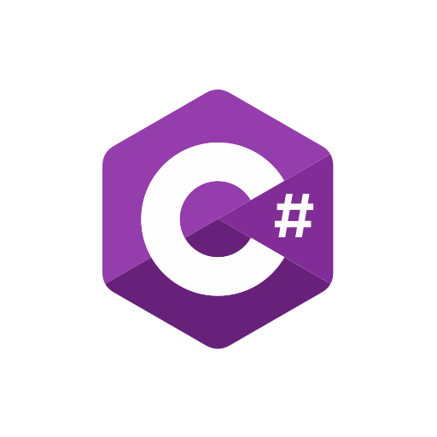
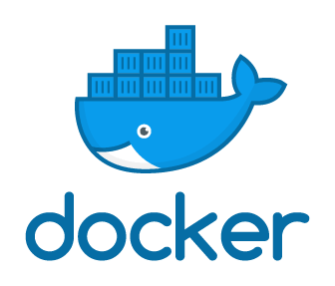
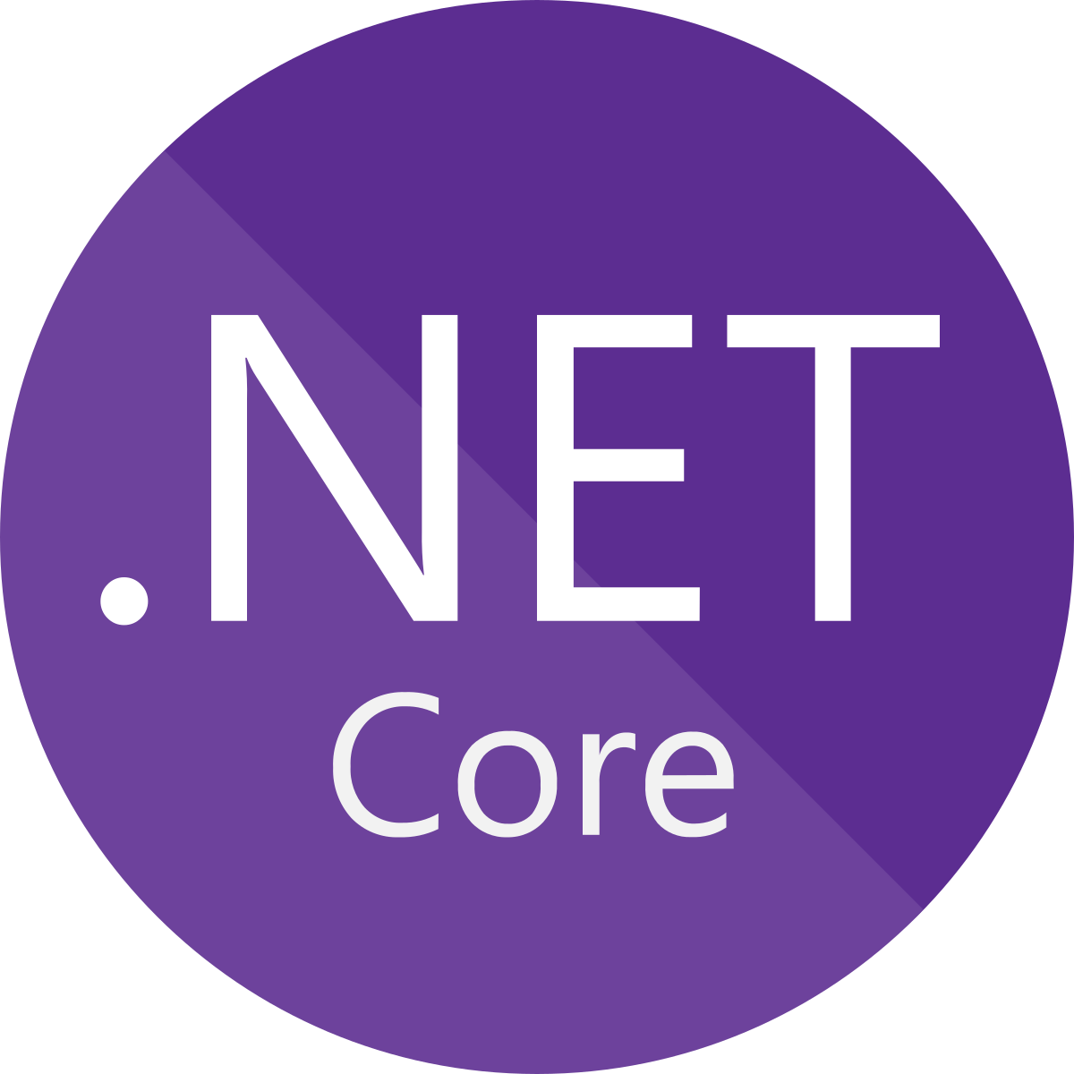
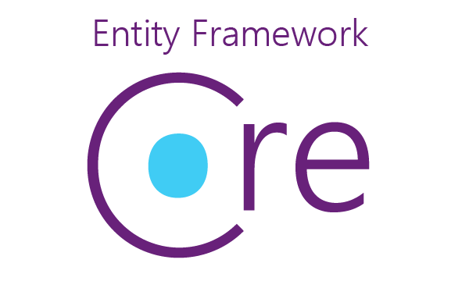
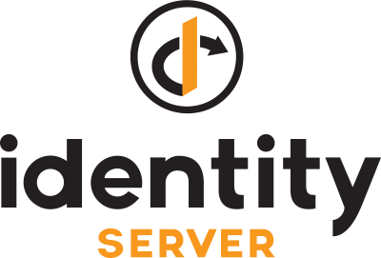

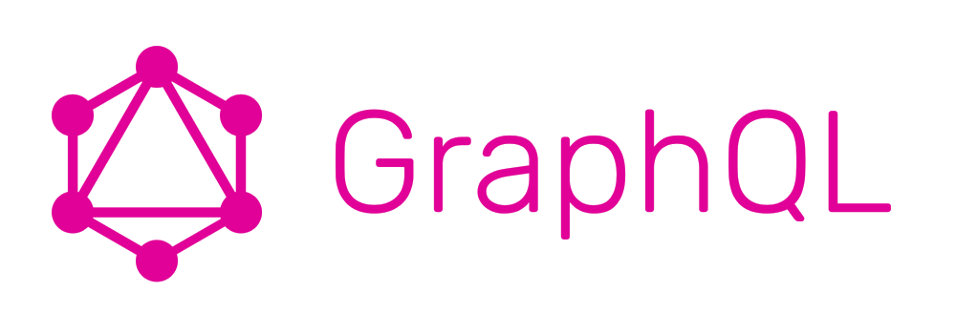

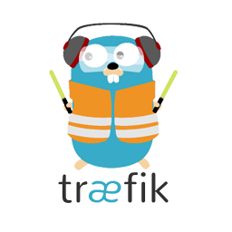


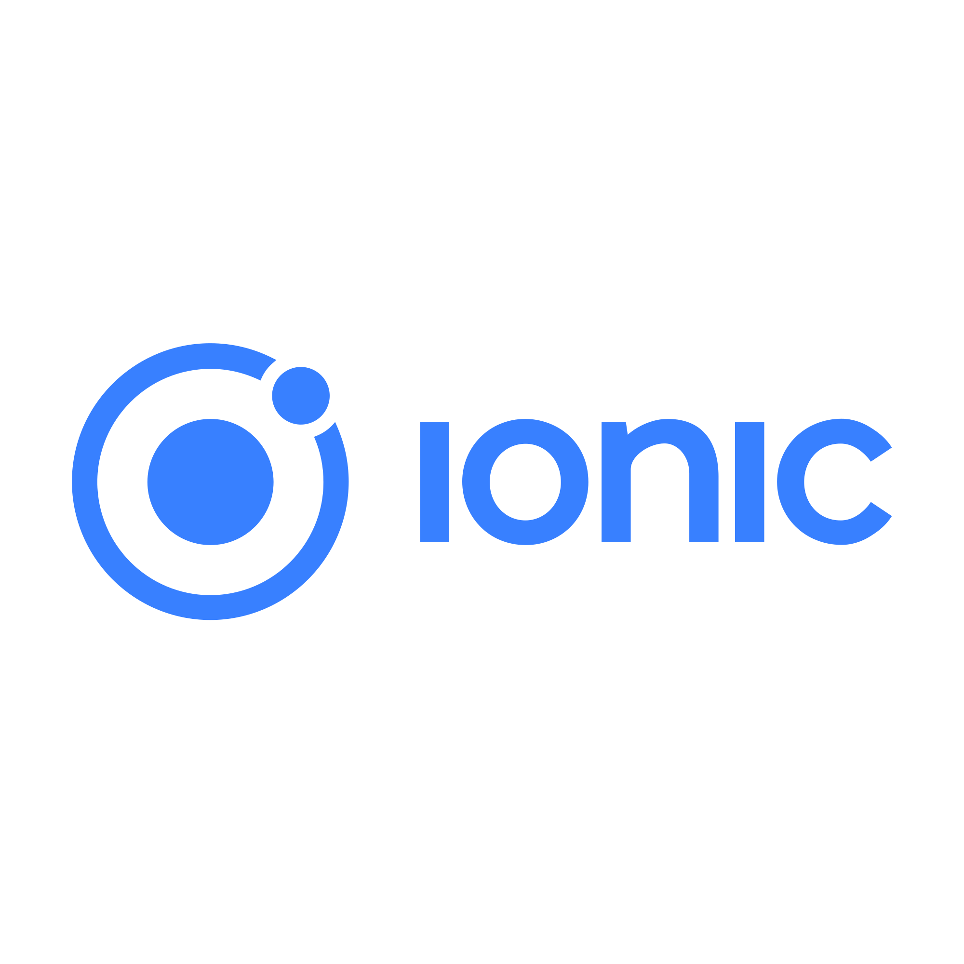


Notes:
Thank you Windjy. With a project this complex. With a scope this large. And a client who is Jason's best friend.
One thing we had realized early on was that we had to do this right. There was no way that we would be able to do everything ourselves.
There are a lot of moving parts, and if we had to write it all from scratch we would need a deadline much larger than the 3 months we had to complete the project. To get past this we came to the conclusion from the very beginning that we would be relying on a core set of middleware and services. Many of which we had never used before, which ties into our larger research budget as mentioned earlier.
In our case. Steve had several key points that he had hit upon with us on the first meeting. The primary being that he was familiar with C# and .NET, and during our initial meeting he made several mentions of this specific technology stack. He had also mentioned that he wanted the application to be:
Designed for Mobile
Scalable
Easily Maintainable
Easily Expandable to support multiple feature sets and future games
And most importantly that he wanted to learn something new for when he took over the project.
With this in mind, we did the research and put together a list of technologies and services that we based our primary architecture around. These technologies being:

Slide 18
Our Foundation - Backend
C# .NET Core Microservice Based Architecture
Docker Compose for Orchestration
IdentityServer4 Authentication
Entity Framework w/ Postgres
RabbitMq/RawRabbit
PokeAPI.co
GraphQL
...and more
What does it look like?
Notes:
A C# .NET Core Microservice Based Architecture for infinite scalability
The microservices hosted inside of Docker Containers
RabbitMQ for communication between our Microservices
Authentication provided by IdentityServer4 and ASP.NET Core Identity
Databases provided by Postgres and Entity Framework
Metadata seeded automatically, on-the-fly through an Open Sourced API, PokeAPI
And last but not least, the glue that holds everything together. GraphQL for our public facing API.
Now this is a lot, but what does it look like?

Slide 19
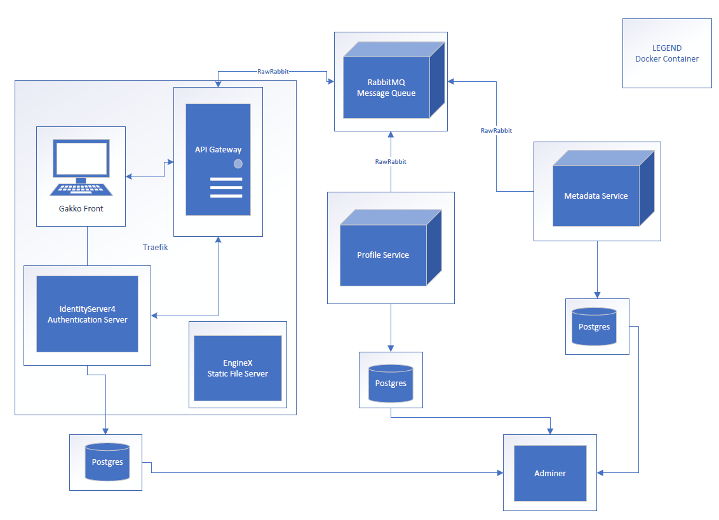
Notes:
This...
Okay, Now, there is a lot going on here. But it’s actually quite simple.
Our architecture has 6 major components:
Our AuthServer
Our API Gateway
Our Profile Service
Our Metadata Service
A RabbitMQ Messaging Server
And of course our Frontend at Gakko Front
These components are dockerized and behind a firewall.
The only components open to the internet is the components within our Traefik Router.
The components, depending on what they do, will, or won’t have a database attached to them.
There are helper dashboards, but they are entirely optional.
Now, with the backend out of the way. Let’s turn our way to the front.
Pat

Slide 20
Our Foundation - Frontend
Ionic 4 (UI Framework)
Angular
TypeScript
Leaflet (Mapping)
Benefits:
Progressive Web Application
Does not require coding in a device’s native language (Swift for iOS, Java for Android)
Sacrifices some performance for ease of development and code reuse
Dynamic without full page loads (SPA)
Type safety and correctness
Notes:
Name technologies:
Ionic, a set of UI components for PWAs
Angular, a frontend framework for developing dynamic SPAs
TypeScript, a type-safe superset of JavaScript
Leaflet, a platform-agnostic mapping library
Describe benefits:
Ionic for easily developing a PWA that can be built for mobile
Great mobile user experience (essential for an application targeting pogo players)
Not as fast as native, but easier dev and more code reuse
Angular for developing an application using Ionic
Most Ionic documentation is in terms of Angular
Results in a dynamic single-page application
TypeScript, the default language used with Angular
Type-safe and maximizes correctness
Rapid development, minimizing bugs
Leaflet for maps on raid page
Using OpenMaps
Onwards to demo...

Slide 21
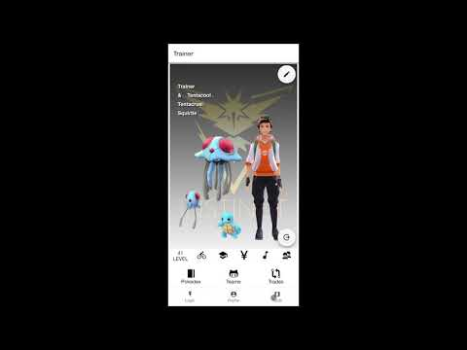
Demo (https://www.youtube.com/watch?v=IdEQ4DichU0)

Slide 22
Challenges
At the beginning of the project, we overestimated our ability, underestimated our timelines, and over promised on deliverables.
Working with new technologies ended up being more time consuming and challenging than anticipated.
Promised the client a demo earlier than we should.
Missteps in communicating with the client
Notes:
Overreaching
- We began this project with lots of enthusiasm. This enthusiasm may have gotten the best of us, as we ended up overreaching, overestimating, and overpromising.
- We saw (and still see) ourselves as an all-star group, and so we felt that we were up to the challenge of this large project.
- Steve presented his ideas for the project to us, and immediately it sounded like quite a large and complicated endeavour.
- Our client however was very understanding and was quite familiar with what he should be expecting. He understood that this was for a project management course, and he did not expect us to meet all of the goals/deliverables he was requesting for the project.
- He allowed us to choose which pieces of the project we planned to deliver on. We assumed we were being reasonable (or going easy on ourselves) by choosing only a few of these features to ship, but even that ended up being more work than we had expected.
- Despite accounting for time to spend on research, it ended up taking much longer than anticipated to learn and adapt to these new and unfamiliar technologies (such as Ionic, Angular, Microservices, etc.). We should have allotted even more time for this than we originally planned.
- In addition to time spent with research, we should have devoted more time to practice (i.e. practicing building applications and components with ionic/angular)
- Additionally, we ran into a few roadblocks during development which we did not expect which set us back further (for me: using a javascript library for the raid map; for back end: connecting everything together, making the api gateway, setting up message queue, using graphql?).
- Moreover, we did not account enough for the time that we had to dedicate to other priorities (other classes, midterms, presentations/current trends course, our jobs, our lives).
- These setbacks ended up throwing our timeline out of whack. Delays piled onto other delays, and we soon realized we had to dial back our scope.
- Due to the aforementioned setbacks, we had not made very much progress with the application for some time and so did not have meaningful updates for the client. Because of this, we postponed contacting the client until much later in the project timeline than we had expected, and we had to push back our demo date.
- In addition to this, by the time we reached out to the client, it had become difficult to reach him (due to technical and scheduling issues).
In addition to this, by the time we reached out to the client, he had become difficult to reach (due to technical and scheduling issues).
- We realized we had bitten off far more than we could chew, and decided to reign in our deliverables (even more than we had initially). We reset our goals and decided to “cut” some of our planned deliverables/scope.
o We still wanted to get the core of a working application delivered, and so we narrowed down our scope to a much more specific set of features. It was less than what we had promised, but would still hopefully be a functional application.
Takeaways and lessons learned
- We learned the hard way to calculate and add extra “buffer” time for the project schedule. In the future, we should try to give ourselves extra time for deadlines to account for unforeseen development roadblocks, or other priorities that may arise.
- Under such a short timeline and with so many other commitments in our lives, we learned that we should have narrowed the scope/deliverables of the project. It is better to be realistic and upfront with a client instead of being overly optimistic with our goals.
- We realized the importance of spending more time to familiarize ourselves with the tools we would be using at the beginning of the project before starting with any actual development.
- We learned a great deal about communicating with a client. We were so concerned with providing a meaningful update on our progress that we did not update the client nearly as often as we should have. It is better to let the client know that there is no news instead of keeping them in the dark or keeping them guessing as to what we are doing at all.
o In the future, we would develop a schedule for updating the client and firmly stick to that schedule.
- In the end, by the time we finally managed to meet with the client he was very understanding and actually very happy with our delivered application.
- As he was quite technical himself, he saw the value in our development decisions and expressed excitement at the possibility of continuing development himself (or maybe, as he mentioned, with Jason).
- Despite all of these pitfalls, we ended up being satisfied with our work ourselves as well. Not only had we learned a lot about the technologies used, but we learned a great deal about project management, collaboration, and communication.

Slide 23
Takeaways and lessons learned
Give ourselves generous estimations for time (or even overestimations)
Consider other priorities or unforeseen delays when planning timelines.
Spend more time upfront researching and familiarizing with newer technology before we begin any development.
Keep consistent communication with the client, even if there is nothing tangible to update them on. Better to not keep them guessing.

Slide 24
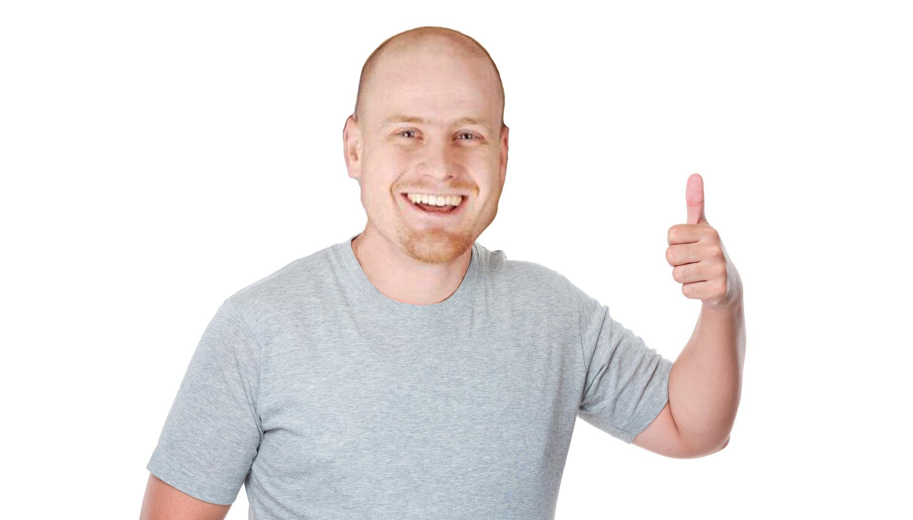
Notes:
Accomplishments
Steve expressed he was happy with our results, technology, and designs
Steve was excited to continue development (with Jason, surprise!)
We made something nice, cool, and fun

Slide 25
Thank you
?
Notes:
Thank you…?

